Slide 1
Tree traversal using stack (preorder)

Slide 2
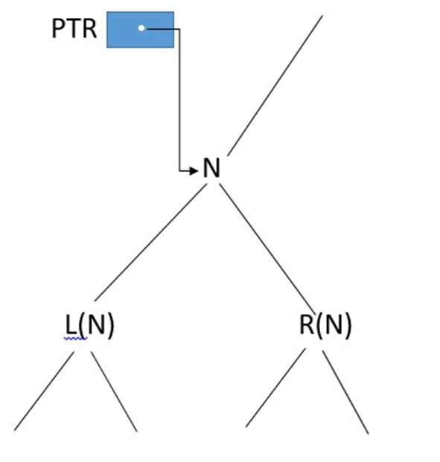
Algorithm
*Initially push NULL onto STACK and then set PTR =ROOT. Then repeat the following steps until PTR=NULL or, equivalently, while PTR != NULL.
a) Proceed down the left-most path rooted at PTR, processing each node N on the path and pushing each right child R(N),if any, onto STACK. The traversing ends after a node N with no left child L(N) is processed. Thus PTR IS updated using the assignment PTR:=LEFT[PTR], and the traversing stops when LEFT[PTR]=NULL)
b) (Backtracking.) Pop and assign to PTR the top element on STACK. If PTR !=NULL, then return to Step (a); otherwise Exit.
*(We note that the initial element NULL on STACK is used as a sentinel.)

Slide 3
Algorithm
(Initially push NULL onto STACK, and initialize PTR) Set TOP:=1, STACK[1]:=NULL and PTR:=ROOT.
Repeat Steps 3 to 5 while PTR != NULL
Apply PROCESS to INFO[PTR]
(Right Child?)
If RIGHT[PTR]!=NULL, then [Push on STACK.] Set TOP:=TOP+1, and STACK[TOP]:=RIGHT[PTR].
(End of If structure.)
5. (Left child?)
If LEFT[PTR]!=NULL, then:
Set PTR:=LEFT[PTR].
Else:[Pop from STACK.]
Set PTR:=Stack[TOP] and TOP:=TOP-1.
(End of If structure.)
(End of Step 2 loop.)
6. Exit

Slide 4
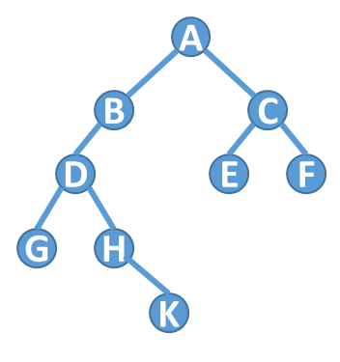
Example
1. Initially push NULL onto STACK: STACK:Ø.
Then set PTR:=A, the root of T.
2. Proceed down the left-most path rooted at PTR=A as follows:
I Process A and push its right child C onto STACK:
STACK =Ø,C.
II Process B.(There is no right child)
III Process D and push its right child H onto STACK:
Stack: Ø, C, H
IV Process G.(There is no right child.)
No other node is processed, since G has no left child.
3. (Backtracking.) Pop the top element H from STACK, and set PTR:=H. This leaves:
STACK= Ø, C.
Since PTR != NULL, return to Step (a) of the algorithm.
4. Proceed down the left-most path rooted at PTR =H as follows:
V Process H and push its right child K onto STACK:
STACK= Ø, C, K.
No other node is processed, since H has no left child.
5. (Backtracking.) Pop K from STACK, and set PTR:=K. This leaves: STACK= Ø ,C.
Since PTR != NULL, return to Step (a) of the algorithm.

Slide 5
Example
6. Proceed down the left-most path rooted at PTR =K as follows:
VI Process K. (There is no right child.)
No other node is processed, since K has no left child.
7. (Backtracking.) Pop C from STACK, and set PTR:=C. This leaves: STACK : Ø.
Since PTR!= NULL, return to Step (a) of the algorithm.
8. Proceed down the left most path rooted at PTR=C as follows:
VII Process C and push its right child F onto STACK: STACK: Ø, F.
VIII Process E.(There is no right child.)
9. (Backtracking.) Pop F from STACK, and set PTR:=F. This leaves: STACK :=Ø
Since PTR!= NULL, return to Step (a) of the algorithm.
10. Proceed down the left-most path rooted at PTR=F as follows:
IX Process F.(There is no right child.)
No other node is processed, since F has no left child.
11. (Backtracking.) Pop the top element NULL from STACK, and set PTR:=NULL. Since PTR=NULL, the algorithm is completed.2

Slide 6
Algorithm
(Initially push NULL onto STACK, and initialize PTR) Set TOP:=1, STACK[1]:=NULL and PTR:=ROOT.
Repeat Steps 3 to 5 while PTR != NULL
Apply PROCESS to INFO[PTR]
(Right Child?)
If RIGHT[PTR]!=NULL, then [Push on STACK.] Set TOP:=TOP+1, and STACK[TOP]:=RIGHT[PTR].
(End of If structure.)
5. (Left child?)
If LEFT[PTR]!=NULL, then:
Set PTR:=LEFT[PTR].
Else:[Pop from STACK.]
Set PTR:=Stack[TOP] and TOP:=TOP-1.
(End of If structure.)
(End of Step 2 loop.)
6. Exit

Slide 7
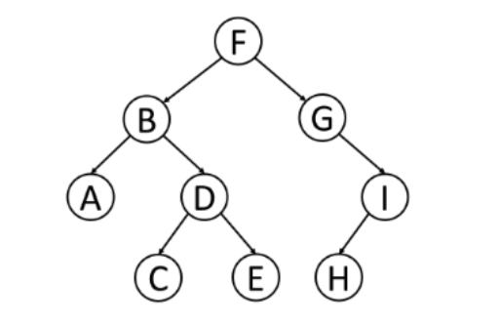
Practice problem

